Slide 1
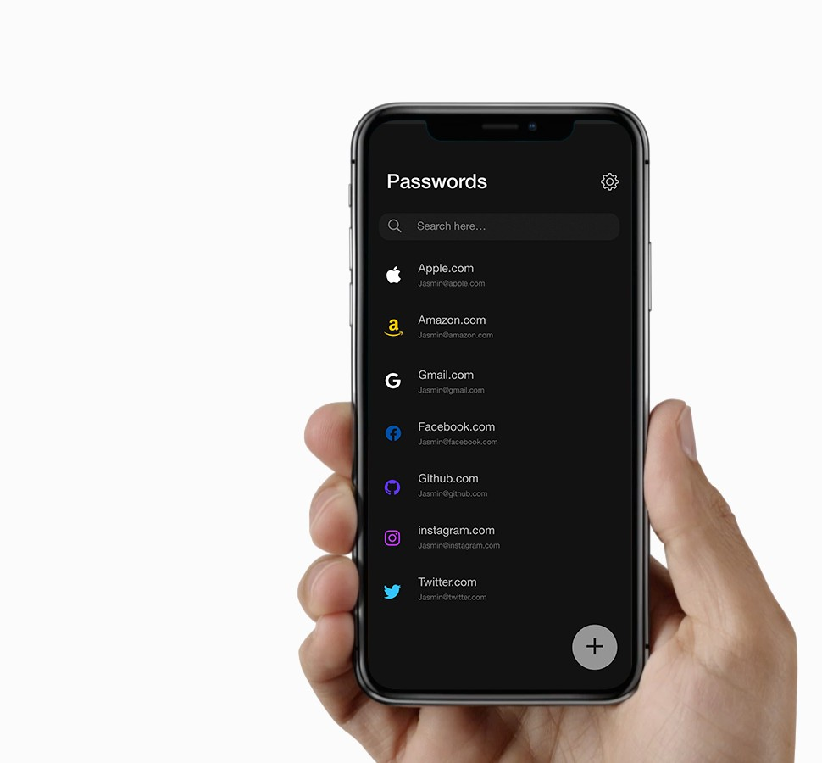

Passbook.co
The safest password manager on earth

Slide 2

Micro level problem
Security anxiety every site you log in to requires complex passwords
Tricky for regular people to manage and understand.
The current products on the market trade convenience for security

Slide 3

Macro level problem
Security is getting harder and harder to manage for businesses
Security decisions taken today can haunt you in the future
Solving security with centralization leads to a fragile world

Slide 4
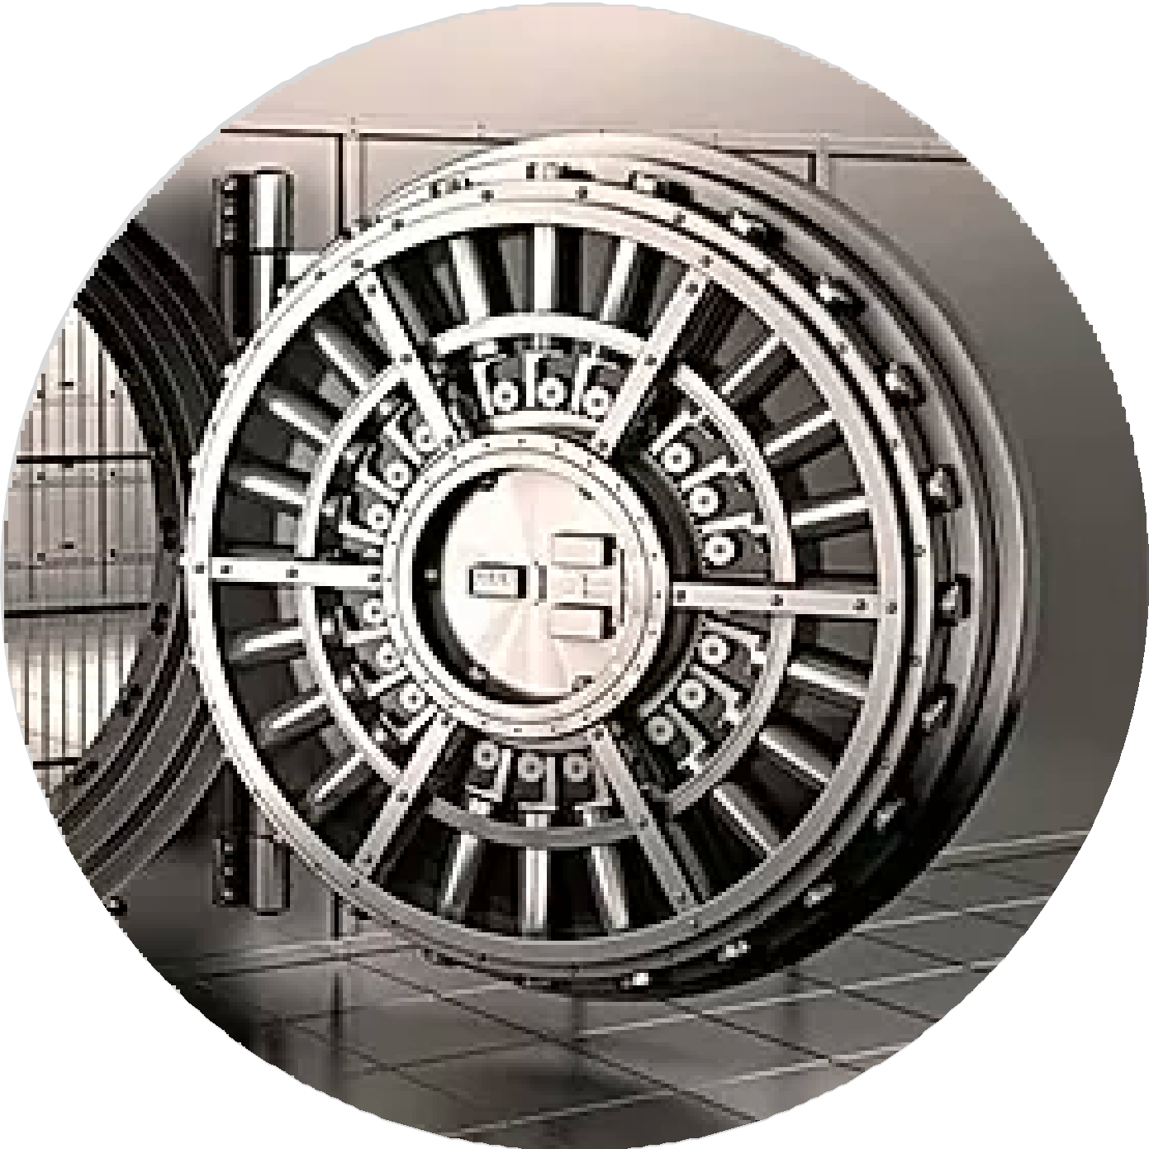
Solution
100% security through AirGapping for the consumer
No trade-oﬀ between convenience and security
Decentralisation, The user manages his own security locally instead of relying on the centralised cloud

Slide 5
Product video
Only plays in keynote presentation or here: bit.ly/xyz123

Slide 6
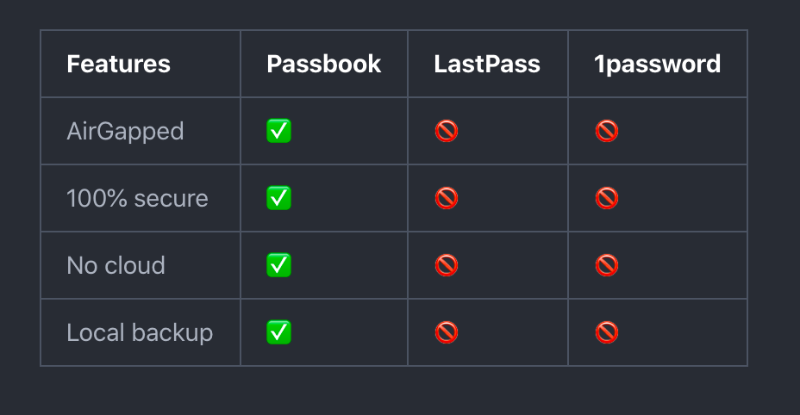
Competitors today
Lastpass.com
1Password
Dashlane

Slide 7

Why now:
CPU/GPU, Camera, Screen are finally fast enough to power Lightstream
Security conciseness is growing: Cambridge-analytica, Covid19, digitalisation of society

Slide 8
Validation
Haze: DNB - Mobile iOS app. “”Looks amazing, you have to come to DNB and do a presentation on this ASAP”
Niclas halvorsen “Sparebanken vest” Looks awesome! Looking forward to test it out”
insert Sindre Sorhus, Google dev, Vincent eche qoutes
Sands. Loved the Lightstream transfer technology
Fredensborg and they were more keen in the authentication aspect of the technology
Dashlane said one of the problems they had was human negligence.

Slide 9
Market opportunity
Today (USD 924.7 million)
In 5 years ($2.05 Billion By 2025)
2.05B $
0.924B $

Slide 10

Go to market strategy
Passbook is the first product that we can launch really quick and without a big budget
Get Passbook on the app-store 2-4
weeks
Get traction with companies that are security conciouse. Get feedback, market validation and tease the Lightstream transfer app on the horizon. Then use that feedback and validation we got from company XYZ to get further funding.

Slide 11

Business model
Clarify to users how storing all your eggs in one basket is not a good idea. The basket being the cloud
Highlighting how the free* Passbook is much smarter than paying a protection-fee of ~10$ per family member for a unsafe solution.
Passbook is free for core functionality and We charge 2.99$ for The sync and backup features.
After initial traction we expand to other security apps that can utilize Lightstream. ID- Authentication, payment, safe file-transfers etc.

Slide 12
Go to market strategy
Passbook is the first product that we can launch really quick and without a big budget
Get Passbook on the app-store 2-4
weeks
Get traction with companies that are security conciouse. Get feedback, market validation and tease the Lightstream transfer app on the horizon. Then use that feedback and validation we got from company XYZ to get further funding.
(Illustration of free features vs paid features)

Slide 13

Growth
Small budget (100k$)
I have the capability to improve the speed of Lightstream alone, but it requires 6-12 months.
Medium budget (500k$)
An alternative is to manage the R&D and hire a math-wiz from USA to finish the math heavy stuﬀ. And then for me to implement it in the app. This will allow Lightstream to become fast enough for sending pictures and presentations in about 3-6 months

Slide 14

Financials:
base level cost for 2 devs (1 full time, other 1/2 time)
build out MVP of passbook
Meetings and lunch with startup investors and companies
Digital infrastructure (Github, Appstore
fee)
Domains: passbook.co 100$, lightstream.io 3500$

Slide 15

Product roadmap
Past: (3 years)
(Lightstream 1-KBPS-speed 2017
Passbook-prototype 2018
Lightstream 10-KBPS 2019
Future:
Passbook-app Q2 2020
Lightstream-file-transfer-app Q2 2021

Slide 16

Long term vision:
Make Lightstream the default technology for local data transfers between all devices.
Establish a Norwegian trust company, similarly how people today trust Apple

Slide 17

Team
Core-team:
André Jørgensen
iOS-dev at Tidal, Telia, Anti and Breel (Ranked Top5 github Norway)
Alexandre Camilleri
iOS-dev from Dashlane, W3C and SEEKERS Capital Group
Business advisors:
Navi (Head of tech, Antler)
Jonas Rinde (webly, CEO of Spotics)
Github org members (Helps with code & advice): Sindre Sorhus
Google guy
Vincent Apple-swift guy

Slide 18

In active development
2000 Commits on GitHub (1800hours work)
One native code base for iPhone and Mac
Working prototype for passbook and Lightstream
Ready to launch Passbook on the app-store within weeks

